Slide 1
QUESTIONS OR CONCERNS
__________________________________________________
__________________________________________________
__________________________________________________
__________________________________________________
__________________________________________________
__________________________________________________
__________________________________________________
__________________________________________________
__________________________________________________
__________________________________________________
__________________________________________________
__________________________________________________
__________________________________________________
__________________________________________________
__________________________________________________
Wedding
Preparation Guide
~And Two Shall Become One~
First United Methodist Church
33112 Grand River Avenue † Farmington, MI 48336
Phone (248) 474-6573 † Fax (248) 474-2624
www.farmingtonfumc.org
Rev. Dr. Anthony R. Hood, Pastor
rev. 5/2023 /pica

Slide 2
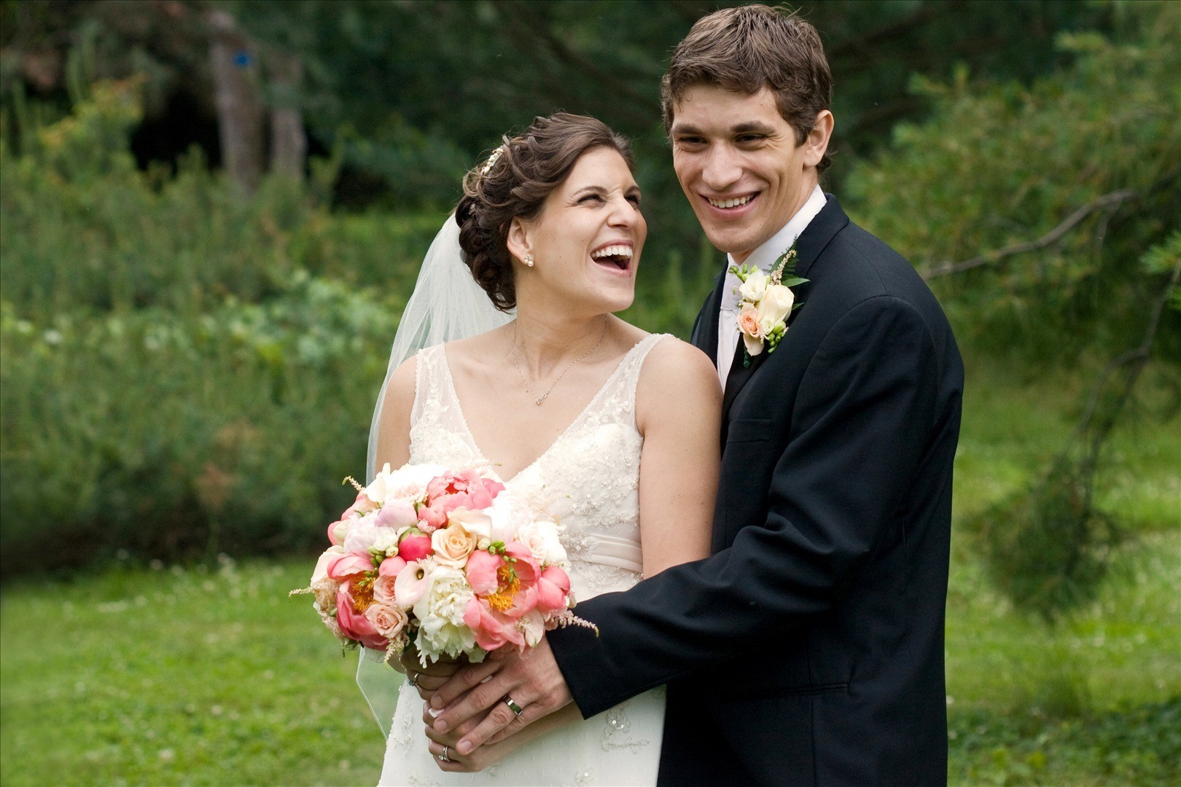
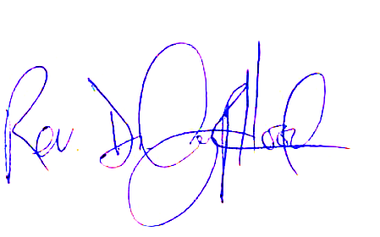
A MESSAGE FROM THE PASTOR…
May God bless and keep you as you move forward toward uniting your hearts. We are honored that you decided to give First United Methodist Church of Farmington the opportunity to participate in this sacred occasion.
To that end, we have prepared the following guide book to help you plan your wedding. These guidelines are to be followed by all persons who will participate in your wedding, as they will aide in allowing your day to be a true blessing. Please take an opportunity to completely review this guide, as it contains vital information as you move forward in your planning.
If you have any questions regarding these guidelines, feel free to contact me. I can be reached at the following numbers: by cell at (313) 283-9919; or the church at (248) 474-6573.
Blessings,
Rev. Dr. Anthony R. Hood
Pastor
WEDDING CHECKLIST
10–12 Months…
Develop a budget and establish top priorities
Compile a preliminary guest list
Choose your wedding party
Find a venue for your ceremony and reception, and reserve your date
Send “Save-The-Date” notice
Find a wedding dress
Secure caterer, photographer/videographer, officiant, wedding planner
6–9 Months…
Find a florist, cake designer, DJ/Entertainment, transportation, invitation stationer
Create gift registry
Order bridesmaid(s), flower girl dresses
3–5 Months…
Book rehearsal and rehearsal dinner location(s)
Reserve all necessary party rentals and linens
Order wedding favors
Reserve men’s formalwear
Finalize the guest list, invitation, ceremony readings and vows, catering details
Purchase wedding rings
Finalize honeymoon plans
6–8 Weeks…
Mail invitations!
Confirm date with vendors
Research marriage license requirements and name-change paperwork
The act of Christian marriage is a Holy occasion and needs to be given a level of reverence appropriate for the occasion. Marriage is a special commitment, not to be entered into lightly. We ask you, and all the participants in your wedding, to remember that getting married in the church is a sacred event. The church is a place where we can meet God and experience the power of His presence.

Slide 3
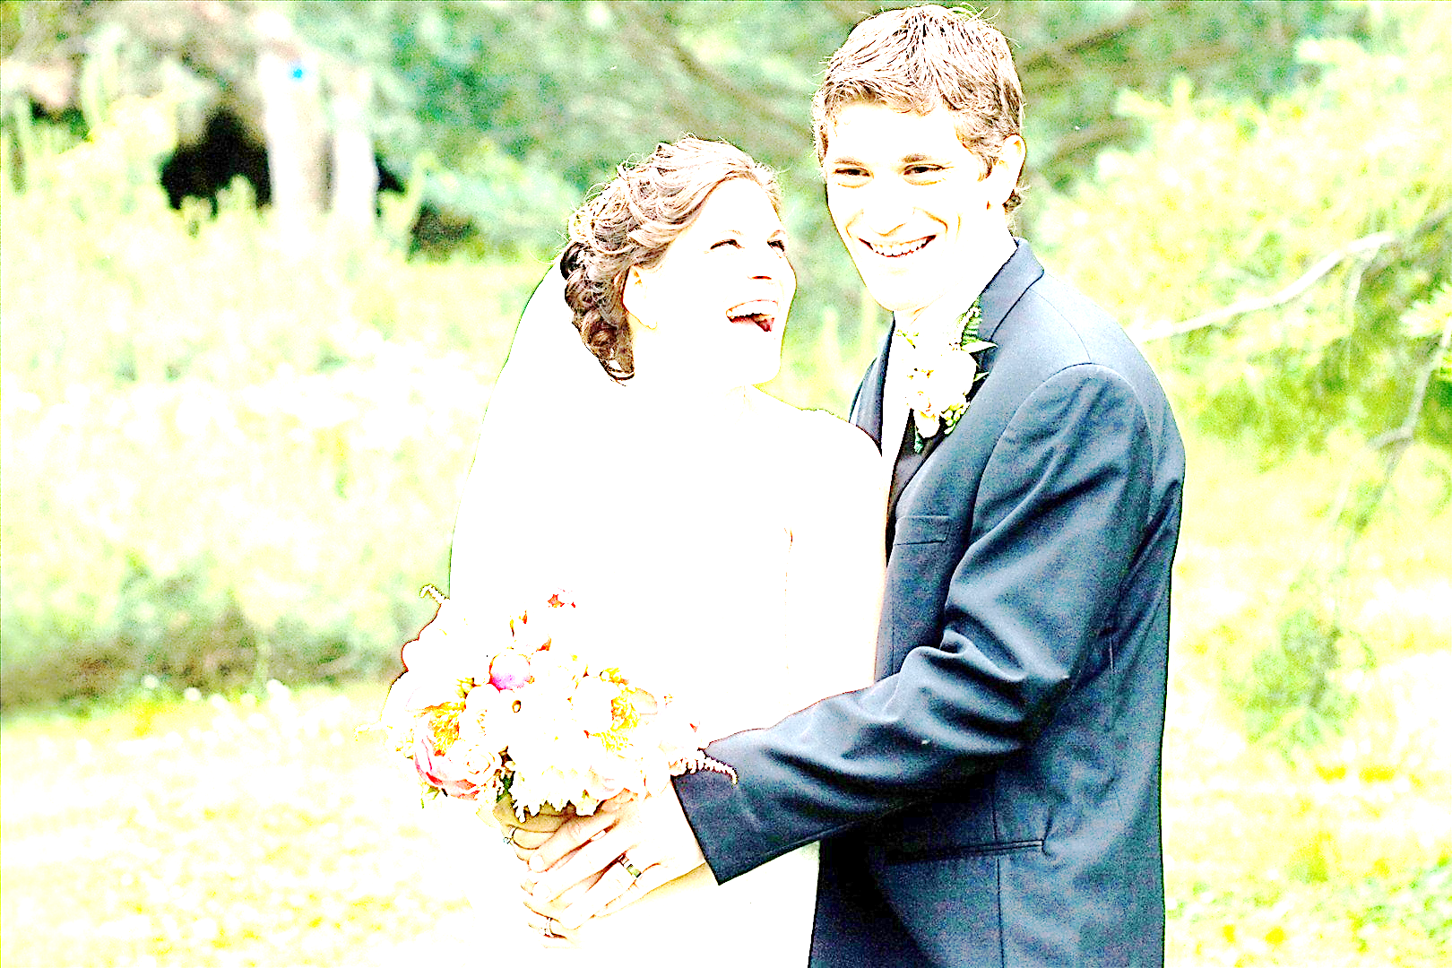
WEDDING CHECKLIST (continued)
3–5 Weeks…
Finalize and confirm:
Wedding vows and readings with your Officiant;
Shot list with your Photographer/Videographer;
Song list with your DJ/musician;
Timeline for the reception and who’s giving the toasts;
Wedding night and honeymoon accommodations
Obtain marriage license and complete name-change documents
Pick up wedding rings and proofread any engraving
Purchase wedding day accessories - guest book, cake servers, etc.
Final dress/attire fittings
1–2 Weeks…
Give your caterer/venue the final guest count
Arrange seating and create the seating chart and/or place cards
Pick up wedding gown
Confirm arrival times and finalize the wedding timeline with vendors and the wedding party
The Day Before…
Assign someone to pack up your gifts/belongings after the reception
Have rehearsal and dinner
Wedding Day…
Arrive early to the church – at least two hours prior to the ceremony
Enjoy your wonderful day!
After the Honeymoon…
Write and send thank-you cards
FREQUENTLY ASKED QUESTIONS
Who do I contact in order to schedule my wedding?
You will need to first contact the Church Administrator, Phyllis Anderson, to confirm the availability of both the pastor and church for your wedding date.
Who can have their wedding at Frist UMC?
Our building is available to anyone in the community who wishes to celebrate the covenant of Christian marriage. However, priority is given to active members of the church and their immediate family when scheduling wedding dates.
How do I reserve my wedding date and the church?
Once you have contacted the Church Administrator to confirm the availability of the church and the pastor for your wedding date, you will receive a Building Usage Contract. In order to reserve your wedding date, you must sign and return this contract to the church, accompanied with a money order or certified check for the $200.00 refundable wedding day deposit. Your wedding date will not be reserved until the signed contract and deposit are received. Certified checks and money orders should be made payable to: First United Methodist Church of Farmington. The only exception is when your wedding will be conducted off-site. In the event of an off-site wedding, the wedding day deposit should be made payable directly to: Rev. Dr. Anthony R. Hood
When is the balance due?
The balance is due no later than 30 days before the wedding date. Failure to remit the balance within this 30 day period may result in the forfeiture of your wedding date. Exceptions are made by the pastor on a case-by-case basis.

Slide 4
What are the fees for using the church facilities for my wedding? The cost for members is $635.00 and for non-members is $1035.00. A total of 4 hours are allotted for your wedding.
Members Non-Members
Pre-marital Counseling $100.00* $150.00*
Wedding Coordinator $150.00 $200.00
Organist $200.00 $200.00
Building Usage Fee 0 $250.00
Custodial Fee (Minor Cleaning) $ 35.00 $ 35.00
Wedding Day Deposit (refundable) $150.00** $200.00**
Off-Site Deposit (refundable) $150.00*** $200.00***
*The pre-marital counseling fee must be paid at the first counseling session.
**This deposit is forfeited if your wedding rehearsal and/or
wedding ceremony begins 30 minutes after the scheduled start time.
***This deposit is made payable to Pastor Anthony and will become
forfeit if the wedding rehearsal and/or the wedding ceremony
begins 30 minutes after the scheduled start time
What are the acceptable methods of payment?
The Church DOES NOT accept personal checks for payment. We accept cash, certified checks and money orders for payment. You may use a personal check to pay the Organist, Wedding Coordinator and Pre-Marital Counseling fee.
When will my deposit(s) be returned?
Your deposit(s) will be returned to you within 10 business days after your wedding, if all of the following criteria have been observed:
All decorations and garbage have been removed from the sanctuary.
You vacated the property two hours after the completion of your wedding ceremony.
All tables, chairs, restrooms, kitchen and the general premises are in good condition.
There is no evidence of the serving and/or consumption of alcoholic beverages.
If I need to cancel my wedding, will I get my deposit back?
Yes, if you cancel, in writing, 30 days prior to the date of your wedding. Failure to honor the 30-day cancellation requirement will result in the forfeiture of all fees and deposits. Exceptions are made strictly on a case-by-case basis.
Does the church offer premarital counseling?
Yes, the pastor requires all couples married at First UMC to complete premarital counseling. Premarital counseling is crucial to the development of a strong marriage. A minimum of six counseling sessions are included in your fee. Couples who have been approved to have an outside clergyperson officiate their wedding, should schedule premarital counseling sessions with that clergy person.
Can outside clergy officiate weddings at First UMC?
The pastor of First UMC of Farmington reserves the right to officiate all weddings held at the church. However, exceptions can be made with the expressed permission of the pastor of First UMC of Farmington.
Is secular music allowed during our wedding ceremony?
In the United Methodist Church, weddings are considered a service of worship. Therefore, the music included should be appropriate for a worship experience. The lyrics to vocal music, should be prayerfully considered, to fit setting of the occasion. It is important that you discuss your thoughts for music with the organist.
The organist, Mr. Yaroslav Daniels, can be reached via email: yarodaniels3@gmail.com or via phone (734) 883-3437. If you have recorded music, please bring it to the rehearsal, so sound adjustments can be made.

Slide 5
What time should the bride, groom and bridal party arrive? The bride, groom and bridal party are expected to arrive two hours before the wedding is officially to begin. The two-hour window allows for any unforeseen incidents while keeping your wedding on track to begin at the scheduled start time. Your wedding photographer can use this time to take group pictures of your bridesmaids and groomsmen.
Will rooms be provided for the bridal party to get dressed? Yes, rooms will be reserved for the bride, bridesmaids, groomsmen and groom to get dressed before the wedding. It is important that all members of the bridal party arrive at the church two (2) hours prior to the scheduled start of the wedding.
When can we decorate the sanctuary for the wedding?
You are invited to begin decorating the sanctuary one (1) hour before the wedding rehearsal, and up to one (1) hour after the wedding rehearsal. Couples are also invited to decorate the sanctuary three (3) hours before the wedding is scheduled to begin. We do not allow the use of nails, tacks, or staples on church walls or furnishings. All decorations must be removed within the first hour after the ceremony has concluded. Failure to do so will result in the forfeiture of your deposit.
Are we required to use First UMC’s wedding coordinator?
Yes, you must use our wedding coordinator for your wedding. Our coordinator is an essential part of your wedding team, able to assist you in ensuring your wedding day is a wonderful experience. She will speak with you in advance to discuss the specifics of your wedding arrangements. Our coordinator is Paula Mullan
(248) 514-2423
Is the wedding rehearsal mandatory?
Yes, a rehearsal is mandatory for all weddings held at First UMC. The wedding rehearsal is essential to ensure that your wedding day is anxiety free. We encourage you to have all the key participants in your wedding present for the rehearsal. It is important that all planning for your wedding be completed before the wedding rehearsal, so the rehearsal starts on time and runs smoothly. The rehearsal is your opportunity to give final instructions to your bridal party. Wedding rehearsals are scheduled the day before the wedding day between 5:00 p.m. and 7:00 p.m.
When should we bring the marriage license?
Bring the marriage license with you to the wedding rehearsal and leave it with the pastor. Please have the bride and groom sign the marriage license prior to, or during the wedding rehearsal. Make sure the two persons designated to sign the marriage license as witnesses are present for the wedding rehearsal. The witnesses need to be present at the wedding rehearsal in order to review the process of completing the marriage license after the wedding ceremony.
Can we make changes to the wedding ceremony?
Couples are welcome to write their own vows to make their wedding ceremony special. However, any changes to the wedding ceremony must be discussed and approved by the pastor.

Slide 6
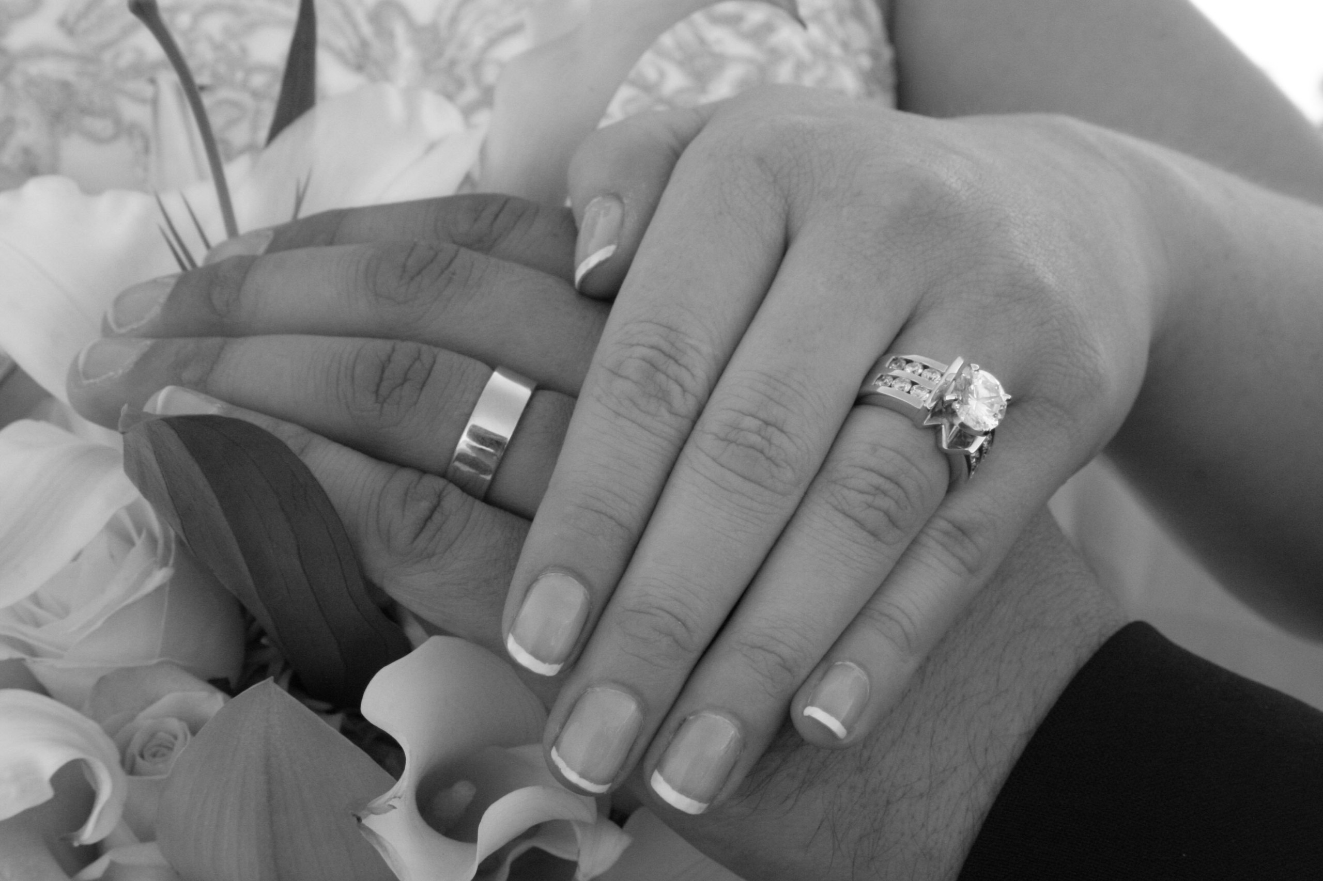
Can we have a photographer/videographer during the ceremony?
The wedding ceremony is a sacred event, celebrating the joining of two souls with God. Therefore, we require photographers and guests to cease flash photography once the wedding ceremony has begun. Please place a note in the wedding program alerting your guest about this stipulation. Photographers are welcome to take pictures of the groom, wedding party and the bride as they proceed into and out of the sanctuary. Many photographers will take the majority of their pictures before and/or after the wedding ceremony. Videographers are welcome to record the entire wedding service from an appropriate distance.
Can I have a vow renewal ceremony at First UMC?
Absolutely! Vow renewal ceremonies are a meaningful way to reaffirm the commitment you made on your wedding day. All usage fees still apply, except the pre-marital counseling fee.
QUESTIONS OR CONCERNS
__________________________________________________
__________________________________________________
__________________________________________________
__________________________________________________
__________________________________________________
__________________________________________________
__________________________________________________
__________________________________________________
__________________________________________________
__________________________________________________
__________________________________________________
__________________________________________________
__________________________________________________
__________________________________________________
__________________________________________________

